Slide 1



PREDICTING ENERGY CONSUMPTION BY SOURCE AND SECTOR (RESIDENTIAL, INDUSTRIAL, AND COMMERCIAL) IN THE STATE OF CALIFORNIA
UCI DATA SCIENCE CAPSTONE 2023
Frank Dong, Nima Hendi, Yang Weng, Sean Lee

Slide 2

INTRODUCTION AND PROJECT SUMMARY

Slide 3

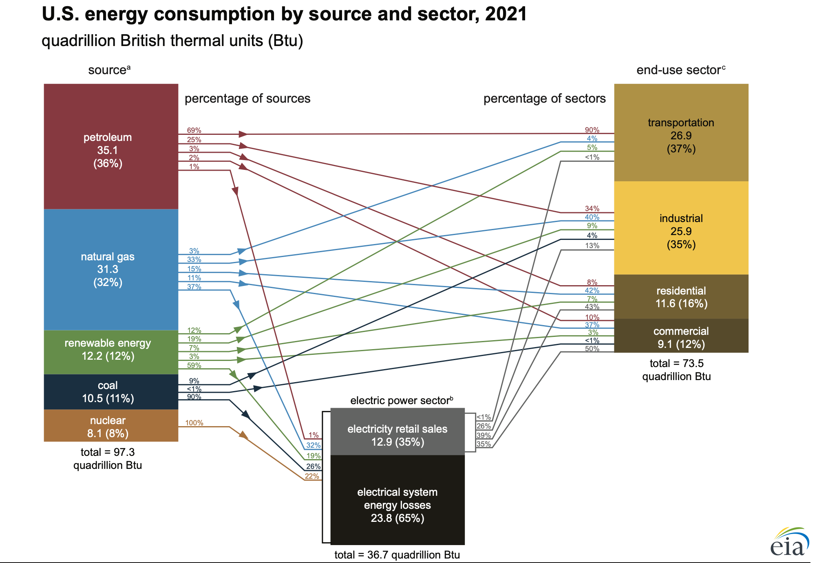
OBJECTIVE
Predicting energy consumption in California based on various price data using machine learning models:
Time Series models such as ARIMA, SARIMAX, Linear, Dense, Multi-Step Dense, and LSTM models
Predictions were made for:
2 years, 5 years, and 10 years into the future
Taking into account factors such as: trends and seasonality, price data, policy changes, and technological advancements.
Source: Energy Information Administration. https://www.eia.gov/energyexplained/us-energy-facts/images/consumption-by-source-and-sector.pdf

Slide 4



SOURCES
Website: https://www.energy.ca.gov/data-reports/energy-almanac/california-electricity-data
Website:
https://www.eia.gov/totalenergy/
Website:
https://www.ca.gov/

Slide 5

DATA DESCRIPTION AND MANAGEMENT

Slide 6
UNDERSTANDING THE DATA
Based on historical data from 1960 to 2020, from CA and US. (more than 10,000 features)
Prediction for the next 2 year (2020-2022), 5 year (2020-2025),and 10 year (2020-2030).
Prediction for energy uses for Coal, Natural Gas, Petroleum, Nuclear, Renewable Energy.
In this project, we will be using data from U.S. Energy Information Administration (https://www.eia.gov/totalenergy/data) and California Energy Commission website (https://www.energy.ca.gov/data-reports). We will be working on datasets that provide yearly energy usage, effects of price, and different needs of resources for different sectors. The data sets will be in CSV and EXCEL formats.

Slide 7
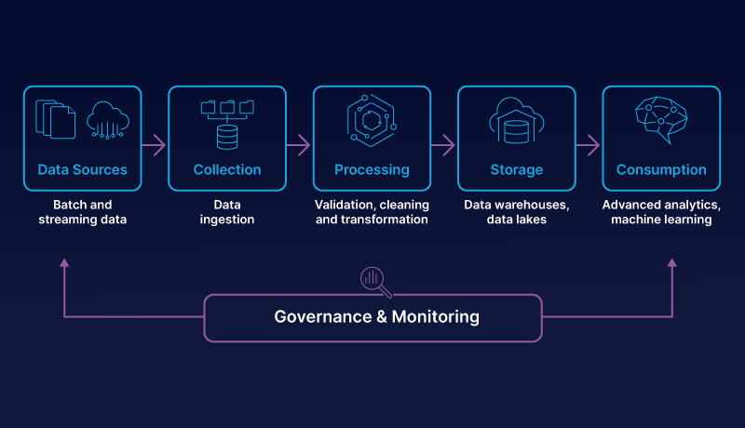
Database (PostgreSql)
Data Pipeline
DATABASE AND PIPELINES
Concatenate target variable and response variable
Transform the data base to be list of features
Convert the value to numerical
Fill in all the NA with 0
Data Normalization
Database store more than ten thousands different features, combined from different category of energy uses, and price.
Data are linked together by MSN index, MSN translation included in data file.
Independent variable: price and consumption table named (All and Price_CA)
Target variable: 5 energy source table and 5 energy sector table.

Slide 8
SAMPLE DATA
Years | ARICD | … | ZWCDP | Residential CA
1970 | 0.49 | … | 3169 | 1192848
… | … | … | … | …
2020 | 12.56 | … | 2539 | 1507721
Residential Energy Consumption Prediction vs price features (named in MSN index):
Predict next year(or specified year) energy consumption based on other given prices.

Slide 9
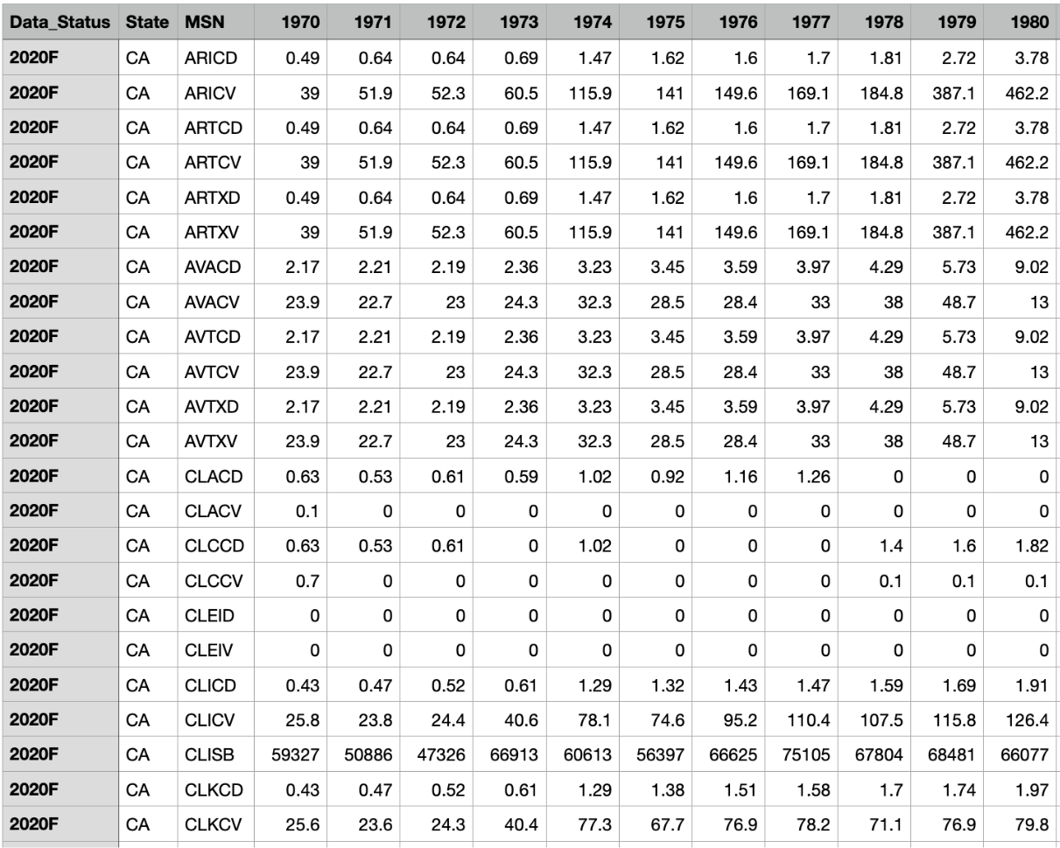
SAMPLE DATA

Slide 10

DATA VISUALIZATION

Slide 11
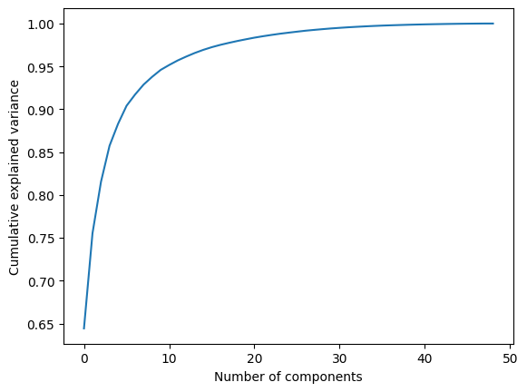
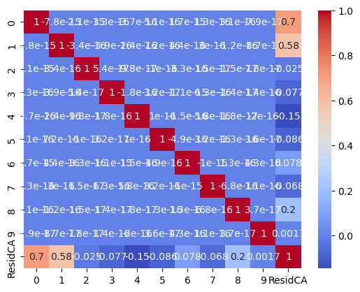
PCA ANALYSIS
Select 10 as hyperparameter for pca analysis

Slide 12
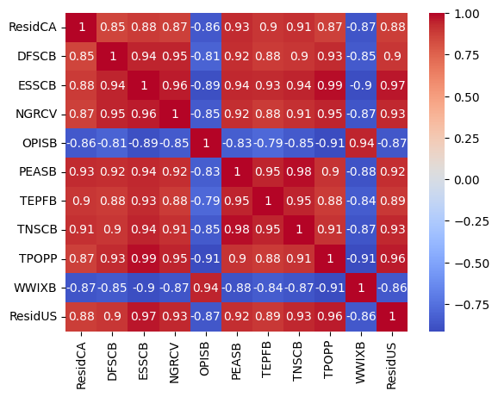
CORRELATION ANALYSIS
Select features with high correlation with target (>0.85)
Eliminate duplicate features such as:
# TNASB & PEASB
# OPSCB & OPISB
Features reduced from 306 to 11
Two year Residential Sector Prediction Sample

Slide 13
Feature Explanation
"DFSCB":"Distillate fuel oil total consumption adjusted for process fuel."
"ESSCB":"Electricity total consumption adjusted for process fuel."
"NGRCV":"Natural gas expenditures in the residential sector"
"OPISB":"Other petroleum products consumed by the industrial sector excluding refinery fuel and intermediate products."
"TEPFB":"Total energy used as process fuel and other consumption that has no direct fuel costs"
"TNSCB":"Total net energy consumption"
"WWIXB" : "Wood and waste consumed by the industrial sector, at no cost."

Slide 14
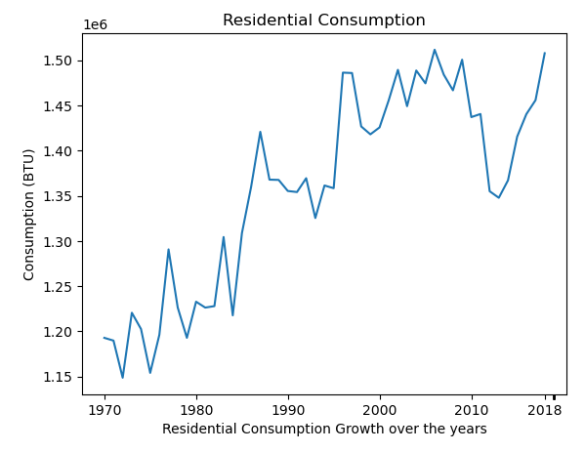
SAMPLE TARGET
California Residential Consumption

Slide 15
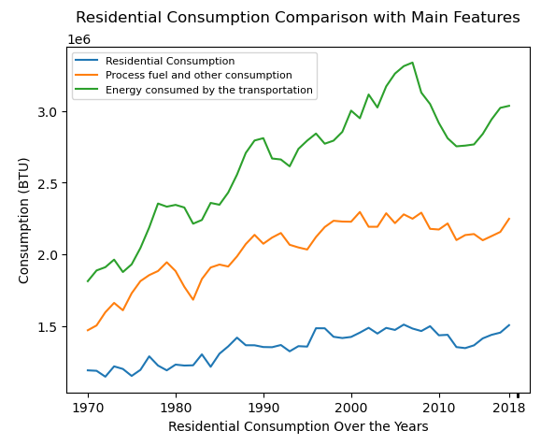
SAMPLE RELATION
California Residential Consumption

Slide 16

PREDICTION AND EVALUATION

Slide 17
SARIMAX
SARIMAX, short for Seasonal Autoregressive Integrated Moving Average with Exogenous Variables, is a time series forecasting model that extends the traditional ARIMA model to incorporate seasonality and exogenous variables. It is a powerful tool for analyzing and forecasting time series data that exhibits seasonal patterns and is influenced by external factors.
SARIMAX is generally preferred when the data exhibits clear seasonal patterns and there are known external factors that influence the time series.
SARIMAX is a statistical model based on autoregressive and moving average components, extended to handle seasonality and exogenous variables. It relies on the assumption that future values depend on past values and can capture linear relationships.

Slide 18
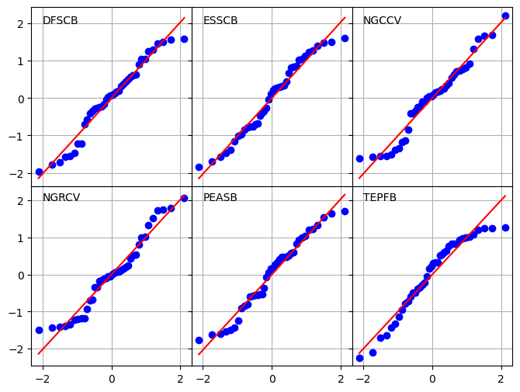
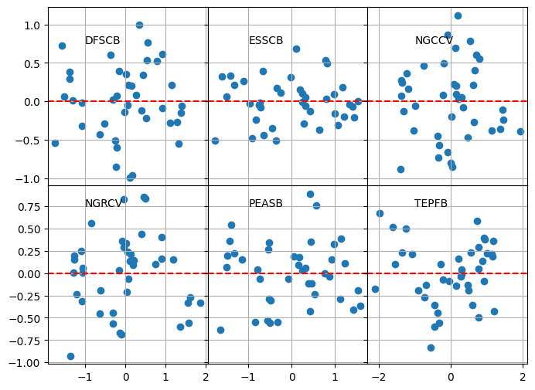
SARIMAX Assumption

Slide 19
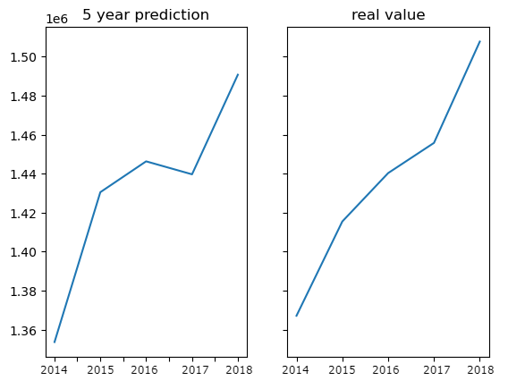
SARIMAX VALIDATION
5 year prediction based on pca data
MAPE: 0.009399553213092346

Slide 20
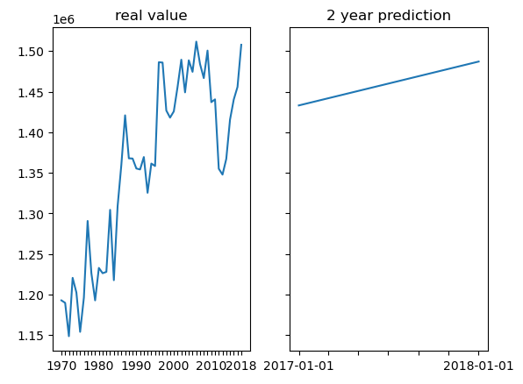
SARIMAX PREDICTION
2 year prediction based on pca data

Slide 21
LSTM
LSTM, short for Long Short-Term Memory, is a type of recurrent neural network (RNN) architecture that has gained significant popularity in the field of deep learning, particularly for modeling sequential data. It is designed to address the vanishing gradient problem of traditional RNNs, allowing it to capture long-term dependencies in time series or sequential data.
The key idea behind LSTMs is the introduction of memory cells, which are capable of storing and accessing information over extended periods. Each memory cell is equipped with a gating mechanism that regulates the flow of information, allowing the LSTM to selectively retain or forget information from previous time steps.
LSTM, on the other hand, is a type of recurrent neural network (RNN) that can model complex nonlinear relationships in time series data. It can capture long-term dependencies and has the ability to learn and extract features from raw data without manual feature engineering.

Slide 22
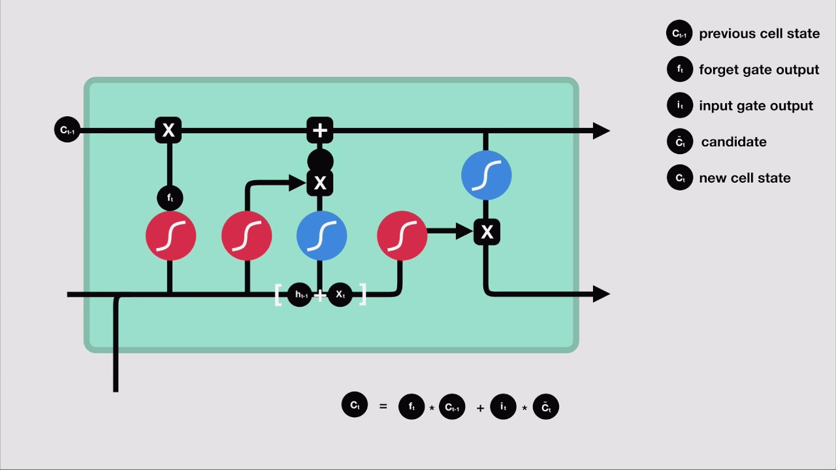
LSTM

Slide 23
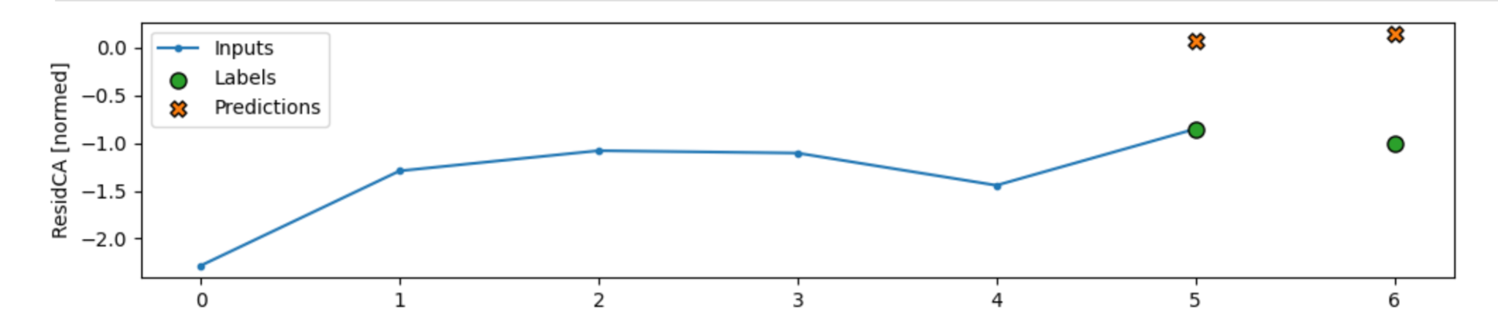
LSTM PREDICTION AND VALIDATION
2 year prediction

Slide 24
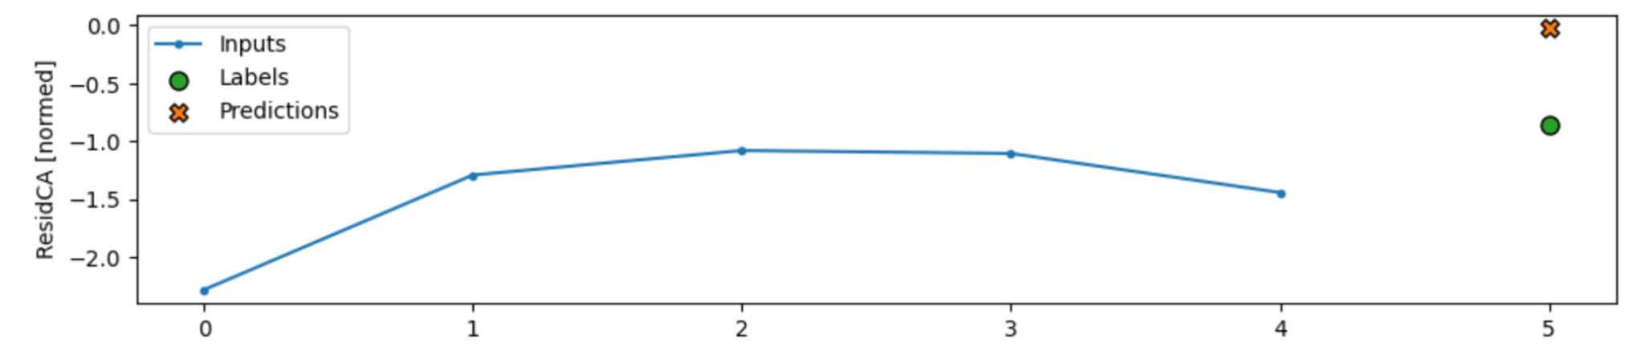
DENSE PREDICTION AND VALIDATION
2 year prediction

Slide 25
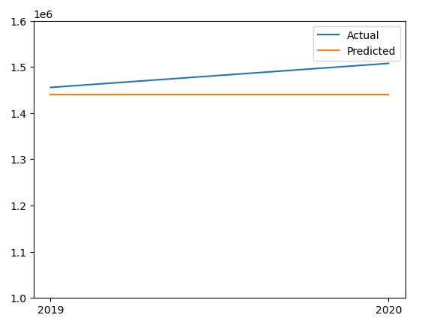
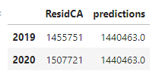
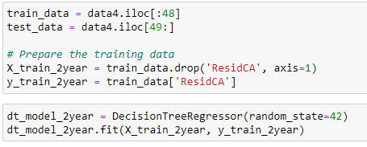
DECISION TREE
PREDICTION AND VALIDATION
2 year prediction
MAPE: 0.027555422500944136

Slide 26
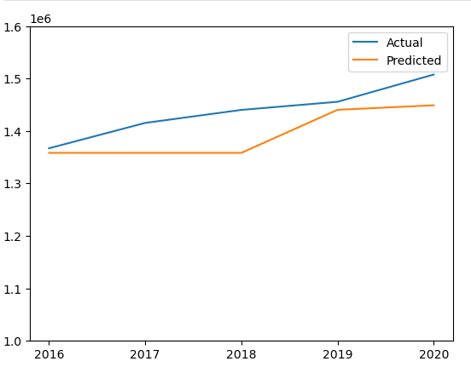
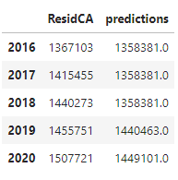
DECISION TREE
PREDICTION AND VALIDATION
5 year prediction
MAPE: 0.03058845284341623

Slide 27
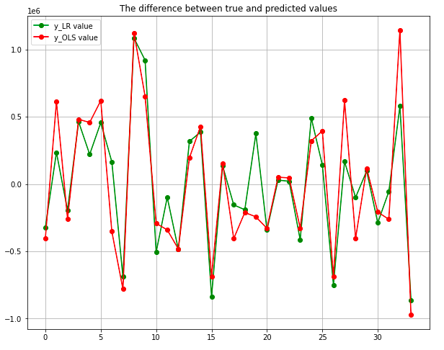
LINEAR REGRESSION PREDICTION AND VALIDATION

Slide 28
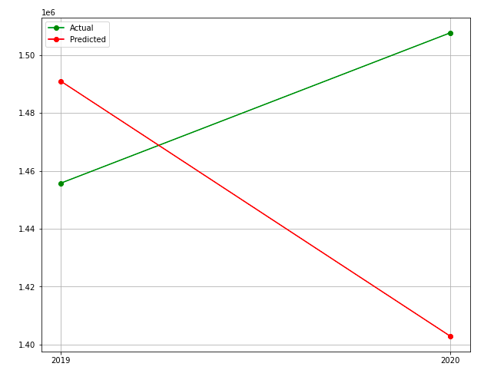
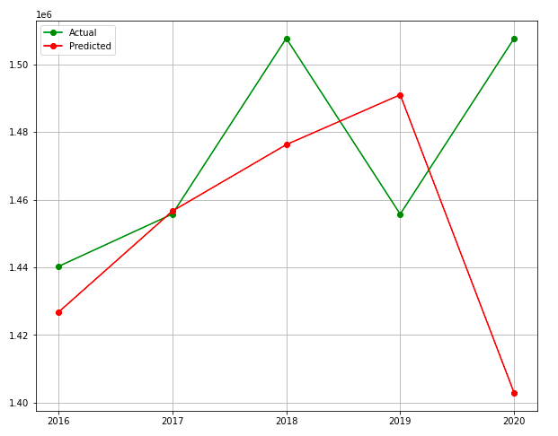
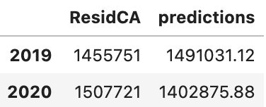
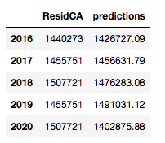
LINEAR REGRESSION PREDICTION AND VALIDATION
2 year prediction
MAPE: 0.04688689937953451
5 year prediction

Slide 29

MILESTONE

Slide 30
MILESTONES
Week 1-2: DATA SETS EDA
High correlation features, PCA, KNN feature selection, and Normalization
Week 3-4: STATISTICAL AND MACHINE LEARNING MODELING
Statistic Model fit, and Machine learning Model fit
(SARIMAX, DENSE, LSTM, Decision Tree, and Linear regression)
Week 5-6: MODEL VALIDATION AND VISUALIZATION
Using different Validation Methods and Visualizations
Week 7-8: MODEL ANALYSIS AND FINALIZATION
Finishing the model and visualizations
Week 9-10: Final Report
Finalizing the Report

